Slide 1
PROJECT FINAL DEFFENCE ON [SUDOKU GAME (ALPHABETICAL)]
PRESENTED BY:
PRAZWOL BISHTA
BIBEK POUDEL
RIKESH LAMA GOLEY
HARI NARAYAN CHAUDHARY

Slide 2
INTRODUCTION
1.1 Background
The history of Sudoku dates back to an 18th Century Swiss mathematician’s game called “Latin Squares”
The game first appeared in Japan in 1984 where it was given the name “Sudoku,”
It was later improved in the modern era and given the name Wordoku when it took on an alphabetical format.

Slide 3
1.2 Problem Statement
Most of us struggle with the question of how to pass the time while we're idle.
1.3 Objectives
The main goal is to make one of the existing sudoku-making techniques (ALPHABETICAL)
1.4 Project Features
Accessible from everywhere if device is provided
Hints are available to make it little easier

Slide 4
1.5. Application
Helps with clarity of mind
Mathematics
1.6 SYSTEM REQUIREMENT
1.6.1 Software Requirement
MinGW compiler or any other
Any IDE software
1.6.2 Hardware Requirement
Any computer device

Slide 5
LITERATURE REVIEW
The first project we reviewed was of Tarun Kumar from “Ims Engineering College, Gaziabaad”
He used Java swing and code blocks to create the project
This project included features like proper GUI, levels etc
We also reviewed another project done by Gokul das

Slide 6
Continue…
In that Project he created soduko game using C#.
Its was consists of Auto generation of sudoku table, sudoku table solver etc
Many of the projects that we reviewed contained features like Generating automatic sudoku table, auto check the correct value, good graphics etc
we decided to combine these feature in our game Wordoku with the reference of sudoku
With these features everyone can play this game with different variant like number as well as alphabetical so they won’t get bored easily

Slide 7
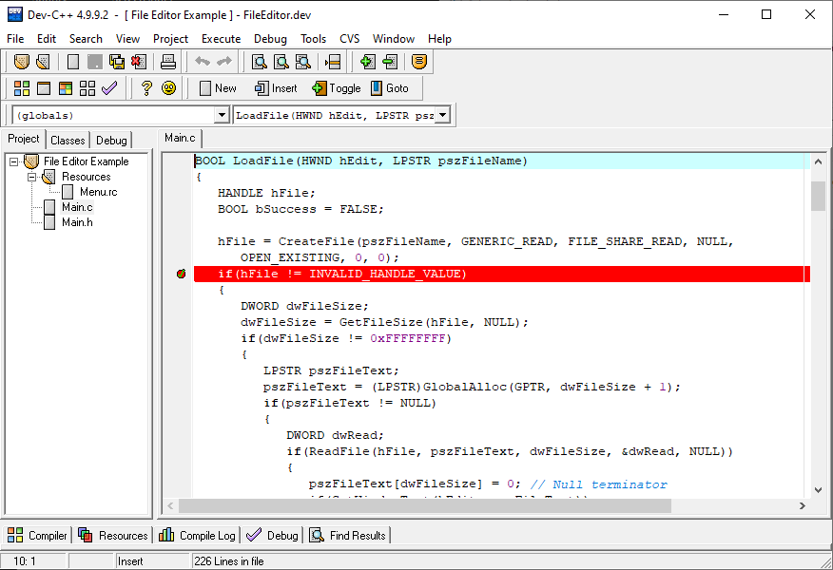
METHODOLOGY
We have used Dev-C++ IDE for development
Dev-C++ is a full-featured C and C++ Integrated Development Environment (IDE) for Windows platforms
Fig: Dev-c++

Slide 8
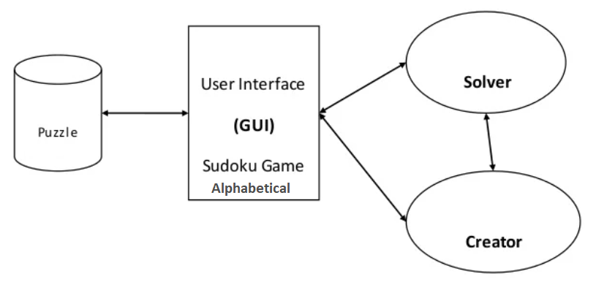
Hardware and software requirement
C programming language is used
Dev-c++ IDE is used
Proposed project block diagram
Fig: Block diagram of Wordoku

Slide 9
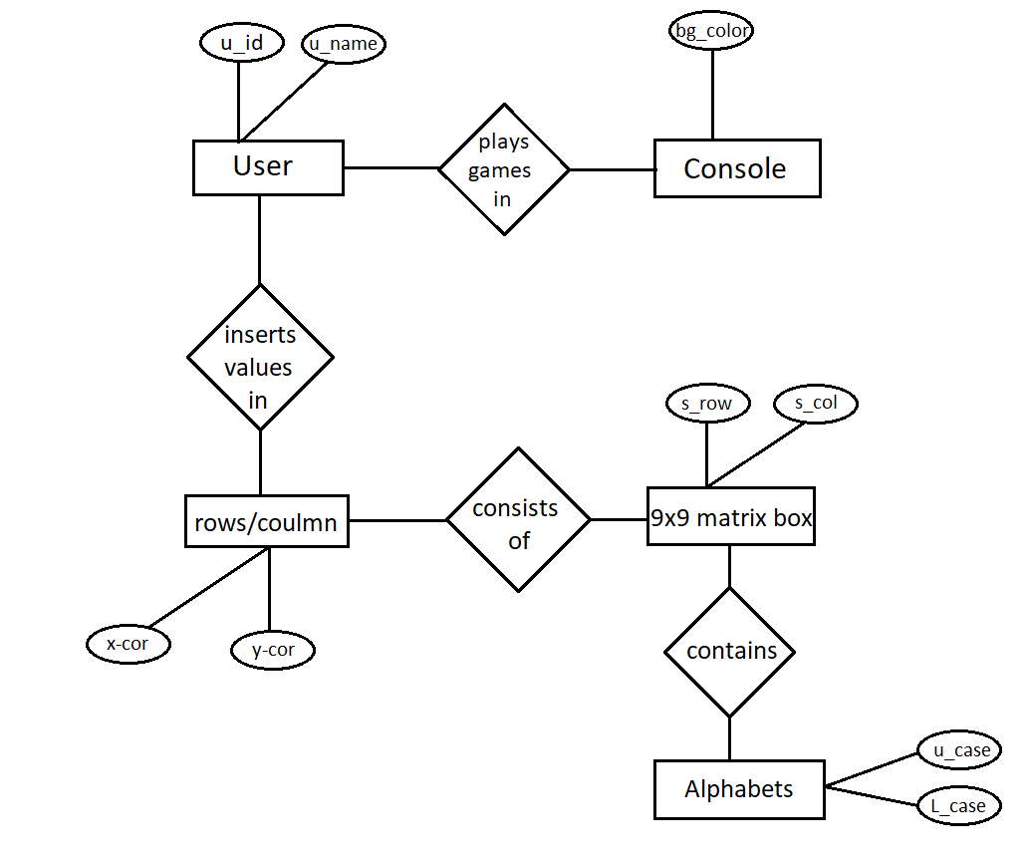
Entity-relationship model

Slide 10
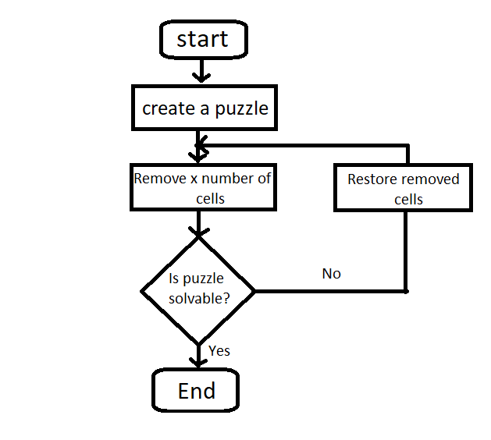
Working principle (flowchart)

Slide 11
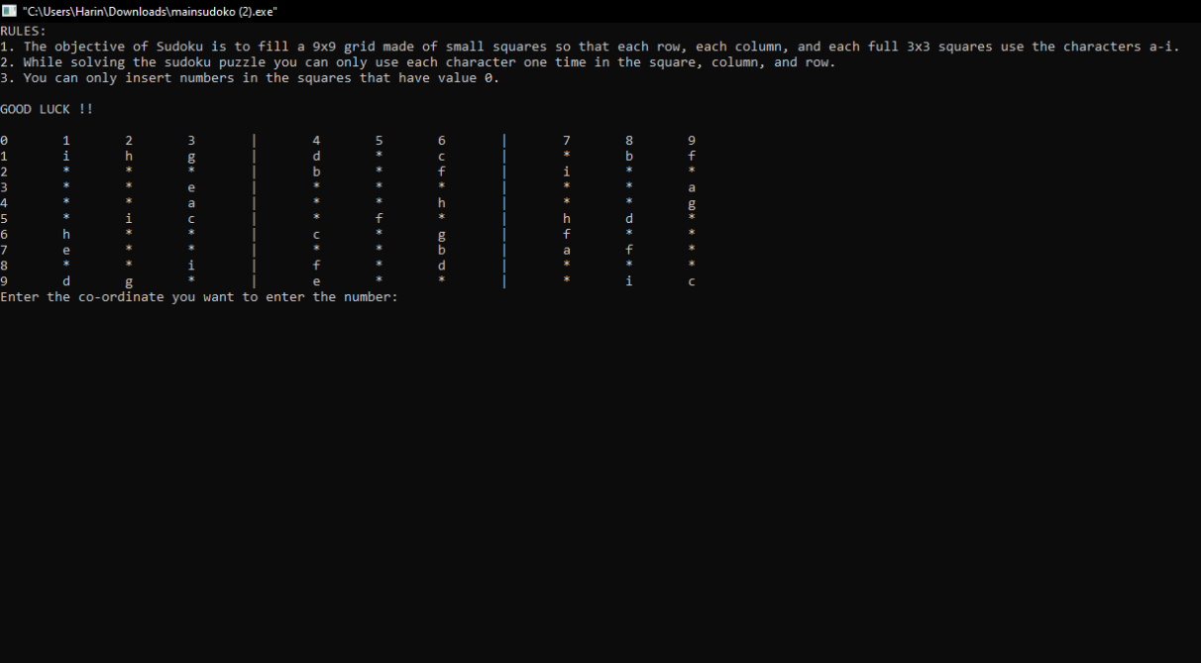
Result and Analysis
we have our console as shown below in the Fig 1:
The rule is given on our initial console as well as the puzzle table
The insertion of character on the table is based as co-ordinate system, we have to give co-ordinate to insert our character at a possible place

Slide 12
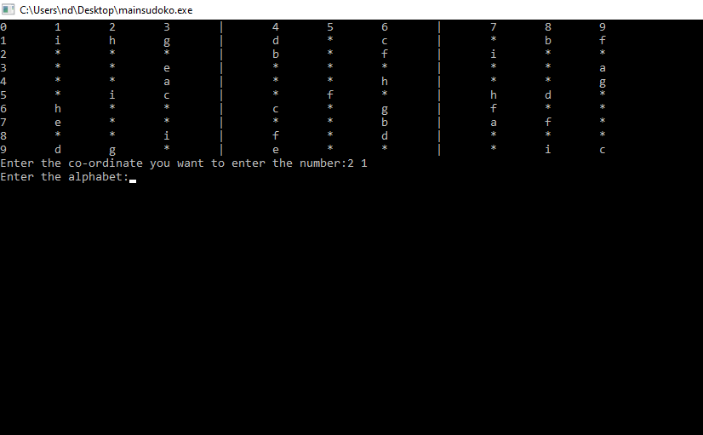
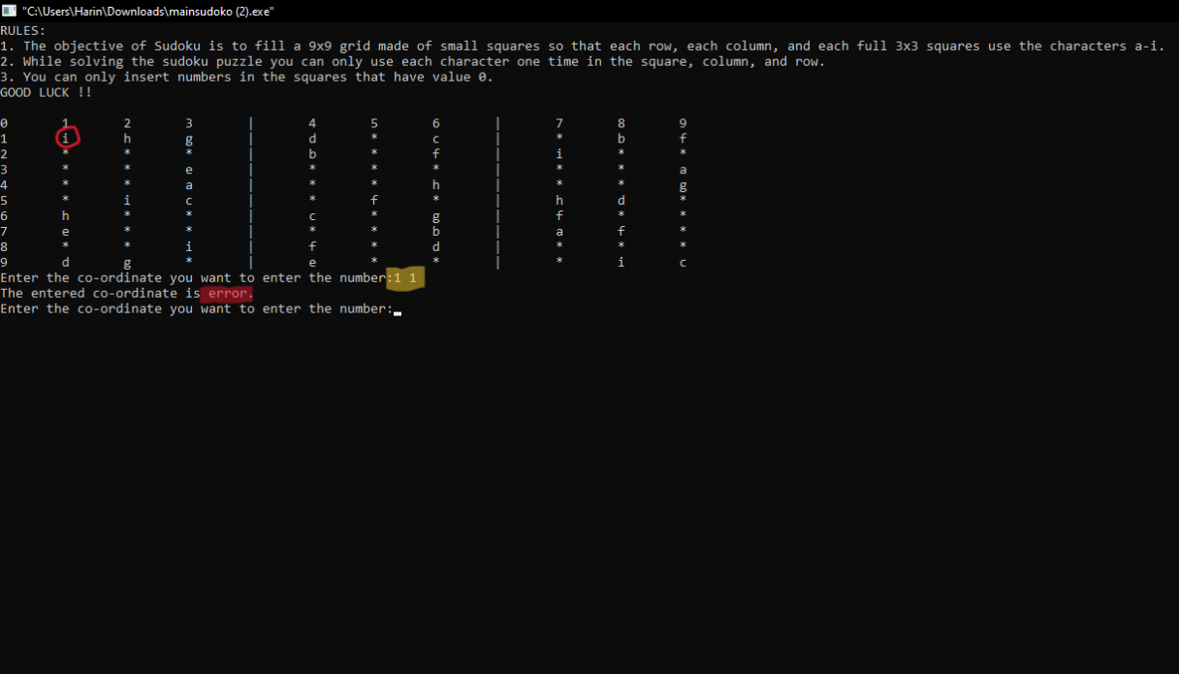
Fig 2: shows the selection of the place by giving co-ordinate
. If user insert the co-ordinate that contain already a character then it shows error as shown in Fig 3:

Slide 13
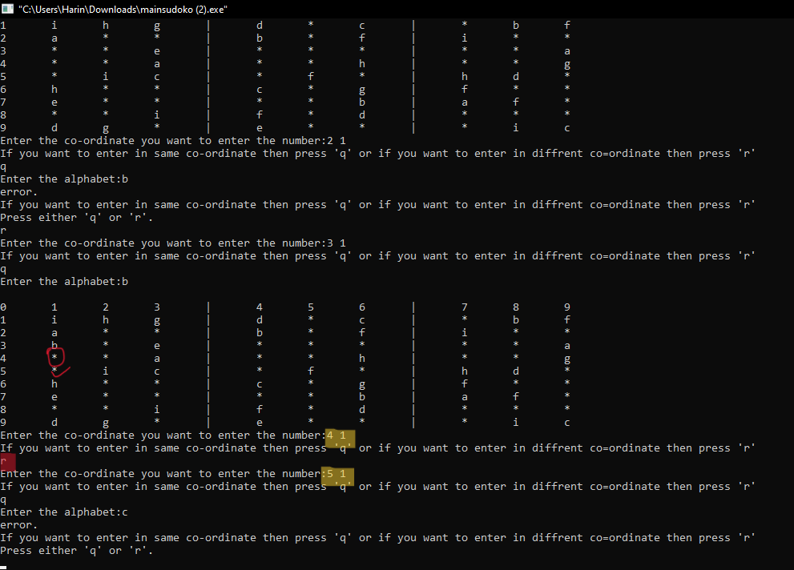
If the user select wrong co-ordinate and want to re-select the co-ordinate that he sure about it, there is a option that user can re-position their co-ordinate as shown in the Fig 4:

Slide 14
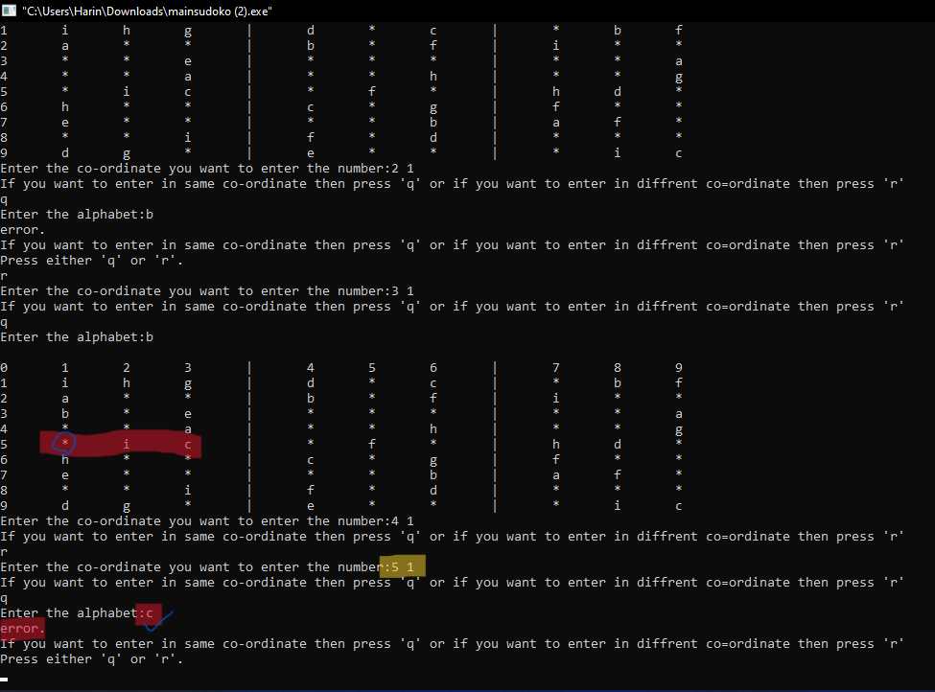
According to the game rule user must not place more than one character in a single row and column though if user insert the character that is already present in a row or column it shows error as shown in the Fig 5:

Slide 15
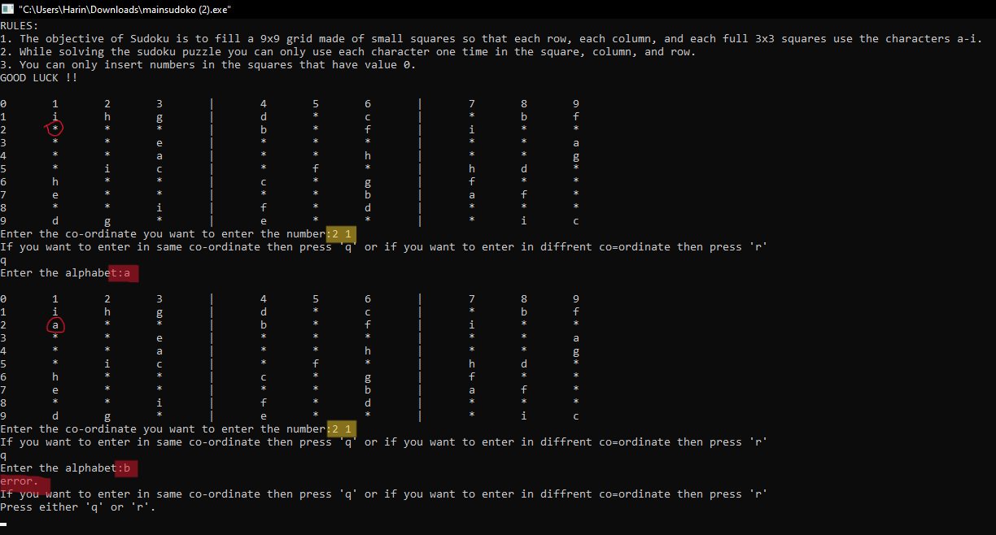
After analyzing our program we found functional error. i.e If the user insert character in one of the available box of the table but later he finds that the inserted value is wrong and he wants to insert other character in that co-ordinate but character is already placed in that box so it throw error which becomes greatest drawback of our program. This shows in the Fig 6:
It is Fixable

